Slide 1

Digital Events Workshop
Business Transformers Academy

Slide 2
Digital Event Workshop
PPT REM 17
01 | Welcome and Intros
02 | Case Study: Microsoft MVP Summit
03 | Digital Event Key Learnings
04 | Virtual Conference Level Set
05 | Virtual Conference Components
06 | Hands-On Exercises
07 | Digital Event Toolkit
07 | Q&A / Discussion / Next Steps
00 – Microsoft Teams Intro 01 – Lab Environment Setup 02 – Lab Notebook Access 03 – Microsoft Lists 04 – Event Registration w/Forms 05 – Event Team and SharePoint Site | 06 – Conference Topic Proposals 07 – Event Planning in Microsoft Planner 08 – Scheduling a Channel Meeting for Breakouts 09 – Scheduling a Teams Live Event for Keynotes 10 – Scheduling a Yammer Live Event for Keynotes 11 – Teams Webinar Demos

Slide 3

Digital Event and Virtual Conferences

Slide 4





What is a Digital Event?
1:1 Meetings and Calls
Interactive Group Meetings
Virtual Events
Townhall
Webinar
Broadcast
Conference

Slide 5
What is a Digital Event?
1:1 Meetings and Calls
Interactive Group Meetings
Virtual Events
Townhall
Webinar
Broadcast
Conference
Company-wide events where leaders and employees stay engaged through open communication
Scale to thousands of attendees, interactions with Q&A and polling, attendee moderation
Online presentations to share information with customers, employees or partners.
Registration, different content layouts to optimize attendee experience, engagement reporting and lobby management
Tailored experiences to reach customers through custom end points and/or streaming services.
Advanced production and content layouts for professional content delivery and/or studio integration
Many channels of content, session formats & attendee networking
Format flexibility with registration, breakout rooms, live keynotes, enabling attendee networking in channels and chat, pre- and post- event engagement

Slide 6












Conference Continuum
Conference
Baseline Event
Calendar invite, list of sessions in a spreadsheet, lots of “join meeting” links
Mid-Tier
Registration, attendee engagement, general sessions and breakouts, asynchronous content, planning and execution.
Flagship
Third-party vendor or partner, turnkey execution, paid or customized event platform
SESSIONS
JOIN NOW
I need more than a list of tracks in Excel, less than an event management platform

Slide 7
Digital Event Planning Timeline
Digital Event
Event Planning
Event Content and Schedule Management
Attendee Experience and Engagement
On Demand
Ongoing
Engagement
Event Team
Event Landing Page
Content Repository and Workstreams
Schedule
Digital Event Platform
Other Platforms
Collaboration
Work Coordination
Landing Page
Registration
Topic Submission/selection
Keynote/Breakout Planning
Speaker Preparation
Attendee Agenda
Attendee Community
Pre-show prep
Pre-event content
Recorded content
Core Content
Recorded content
Attendee Community
Interstitial Content
Interactive Sessions
Digital meetups

Slide 8
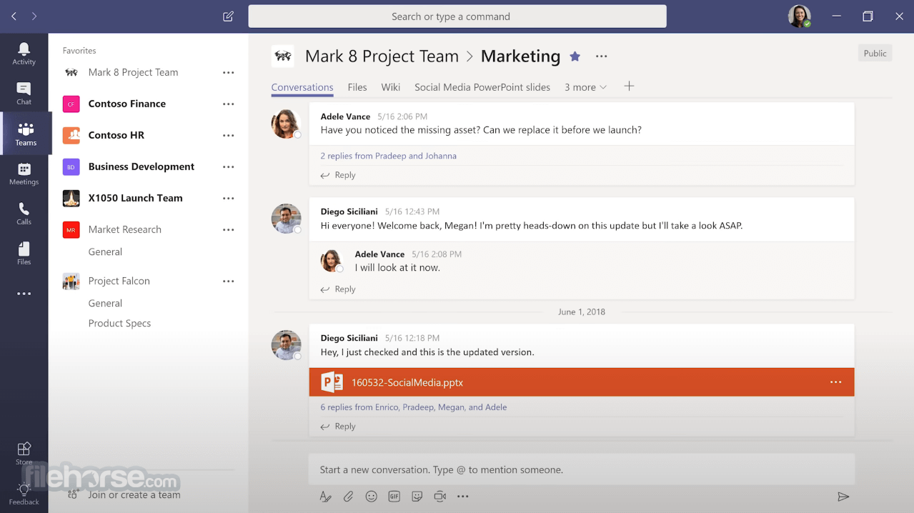
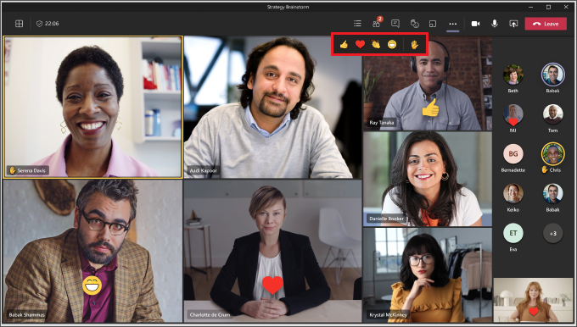
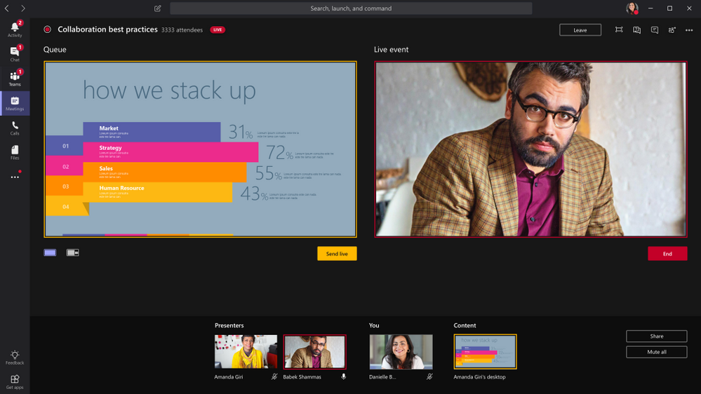
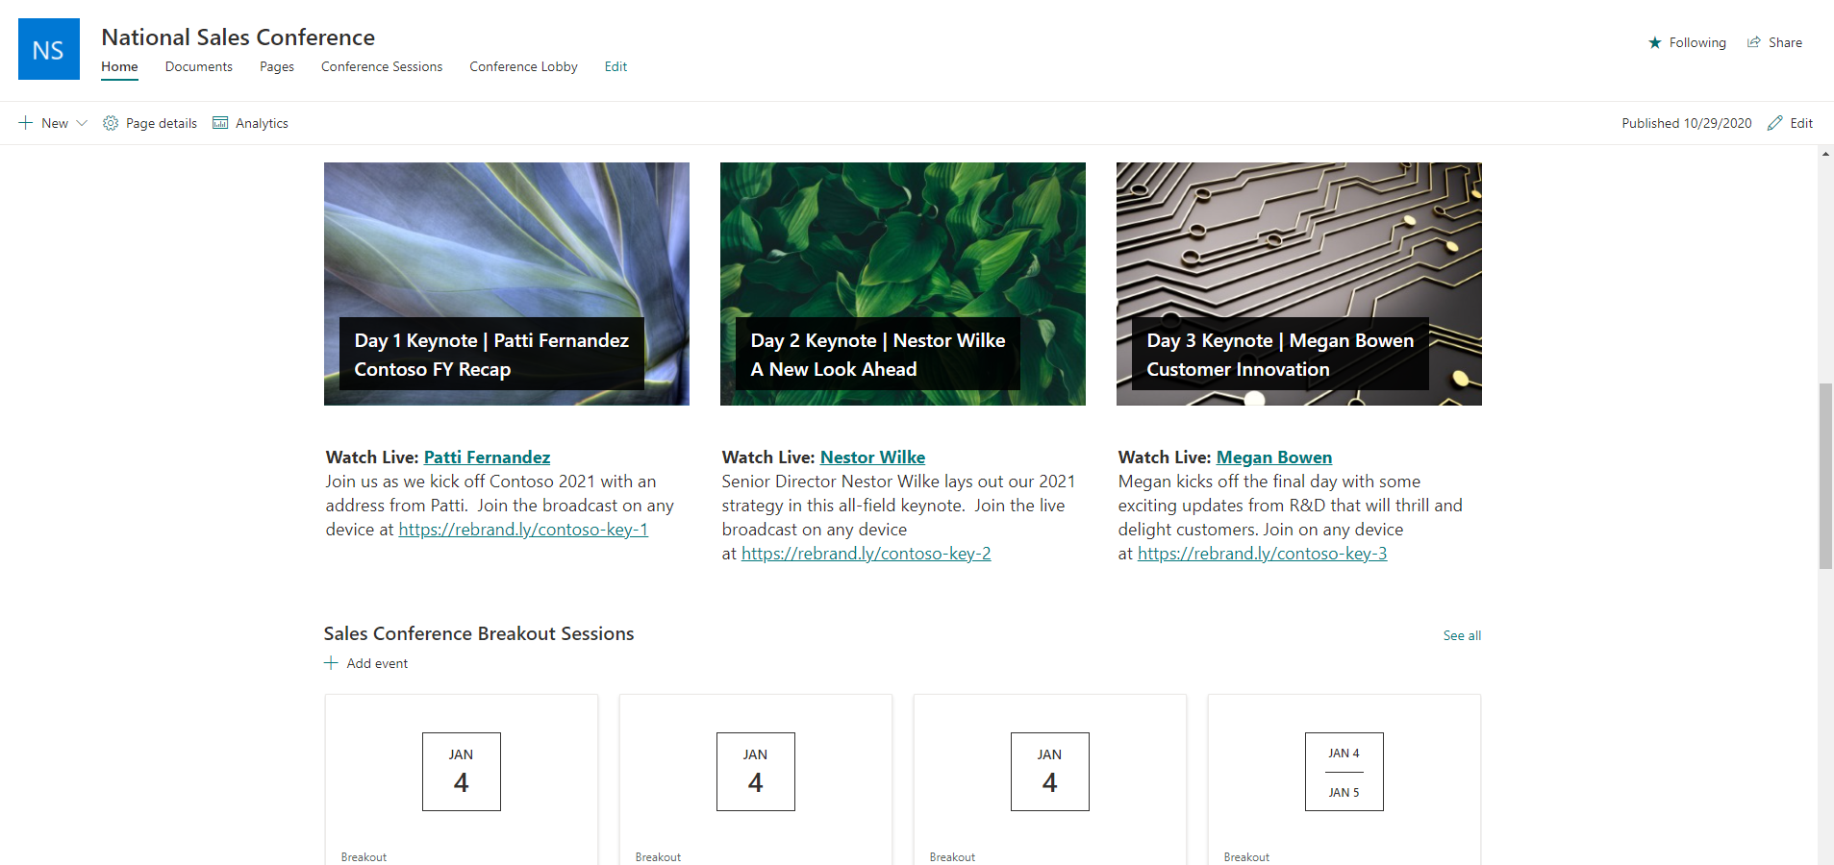
Microsoft 365 Event Toolbox
Microsoft Teams
Plan, Coordinate, and host Virtual Events and Town Halls
Integrate Microsoft 365 tools like Planner and Lists to manage work and runway
Teams Meetings
Interactive, Immersive, up to 300 people (250 GCC)
New Capabilities
Attendee Engagement
Presenter Tools
Registration, Reporting
1000 attendee meetings, 10,000 view-only Experience
Microsoft 365 Live Events
Broadcast events that use Teams or an External Encoder to generate a media stream
Host in Microsoft Stream, Yammer, or Teams
Scale to 100,000 internal attendees on request
SharePoint, Yammer
Internal landing page for large digital events and communities
Immersive VR experience for virtual continuity

Slide 9







Virtual Conference Components
 | Event Planning | Event Content | Attendee Experience | Reports and Analytics
Typical Components of a Virtual or Digital Event | Event Team Collaboration Space Place for event team to collaborate Event Planning and Coordination Manage work, tasks, deadlines, milestones Event Landing Page Portal for event details and access Registration Attendee and speaker management Speaker Prep Preparing SME for digital delivery | Core Content Inform and Inspire in Keynotes, General Sessions, and Hero Stream delivery Interactive Sessions Learning-focused topic or role breakouts Recorded Content Delivery Asynchronous content for pre/post event recording and viewing Content Repository and Workstreams Location (folder or library) for pre/post event slides, documents; templates for branding Event Topic Selection/Catalog/Schedule Agenda, Speaker Bios, Session Descriptions | Digital Meetups Meeting and networking with other attendees and speakers Interstitial Content Energy Attendee Participation Viewing and participating in event sessions Feedback & Evaluations Session evaluations, formal surveys, event feedback Design and Accessibility Accessibility is designed into the experience | Registration Dashboard Summary of event registration, demographics, analysis. Keynote, Main Tent, Breakout Reports Analysis of viewing and engagement participation and telemetry Evaluation Analysis Analysis/dashboard of polls and evaluations
Microsoft 365 Capabilities | Microsoft Teams – Create a Team for event team w/Channels for sub-projects, speaker office hours Microsoft Planner - Simple, visual way to organize event prep and execution. Microsoft Forms - Quickly and easily create custom registrations forms SharePoint Communications Site – Visually appealing site w details SharePoint Spaces - Immersive 3D mixed reality experience to augment event content Presenter Coach – PowerPoint online tool Teams Meetings and Live Events - Training Other: Microsoft Lists, Yammer Event, Speaker training resources | Live Events - Real time, HD video/content and interactive Q&A Teams Meetings – Standalone or Channel meetings for breakout sessions or tracks. PowerPoint Designer Templates – For branding Teams Files/SharePoint Library - For managing and tracking content (slide decks, documents, etc.) Microsoft Stream – Share and interacted with recorded video content Microsoft Lists – Big list of sessions, titles, speakers, bios, description (or Excel!) | Live Events , Meetings , Stream - Access event content real time or on demand SharePoint Communications Site Access agenda, add-to-my-calendar, event details Teams Files, Teams Channels - Access session slides, documents; Channels for tracks or roles Yammer, Teams – Attendee community building and networking in Yammer, in Teams, or both Microsoft Forms – Polls and surveys for feedback Office Accessibility Center - Ensure event content is accessible to attendees Microsoft Teams Accessibility – Make meeting and streaming content accessible | Microsoft Power BI – Create custom interactive visualizations of event data, registration, feedback Teams Analytics and Reporting - Insights into how users in your organization are using Teams. Power BI Dashboard for Live Event Analysis – Analyze live events with rich user insights.
Teams Apps | Incident Reporter - Capture/manage problems that occur Staff Check-ins – Speaker/Moderator Check-In | Ask Away - AMA style breakouts, community Company Communicator Announcements, Info Surveymonkey, Poll, Forms, or Polly for audience engagement, feedback Freehand, Whiteboard for interactive design | Employee Training App Template FAQ Plus - Attendee Q&A, housekeeping? Icebreaker – Attendee intros Kahoot – Kahoot’s Microsoft Teams App Custom Stickers – For session interactivity | Ask Away – Submit/upvote Q&A for top-of-mind Poll – Quickly create/send polls in chat Remote Support – For event helpdesk requests

